Slide 1
PL/SQL - FTP
Date : 01/12/2014
Process
Results

Slide 2
Session Objective
Need for PL/SQL
Types of PL/SQL blocks
Variables and initialization
Various data types
Identify the benefits of using the %TYPE attribute
Cursors
Use simple loops and cursor FOR loops to fetch data

Slide 3





What is PL/SQL
PL/SQL:
Stands for Procedural Language extension to SQL
Is Oracle Corporation’s standard data access language for relational databases
Seamlessly integrates procedural constructs with SQL

Slide 4
About PL/SQl
PL/SQL:
Provides a block structure for executable units of code. Maintenance of code is made easier with such a well-defined structure.
Provides procedural constructs such as:
Variables, constants, and types
Control structures such as conditional statements and loops
Reusable program units that are written once and executed many times

Slide 5

PL/SQL Environment
PL/SQL engine
PL/SQL Block
procedural
Procedural Statement Executor
SQL
SQL Statement Executor
Oracle Database Server
Notes:
PL/SQL Environment
The slide shows the PL/SQL execution environment in the Oracle Database server. A PL/SQL block contains procedural statements and SQL statements. When you submit the PL/SQL block to the server, the PL/SQL engine first parses the block. The PL/SQL engine identifies the procedural statements and SQL statements. It passes the procedural statements to the procedural statement executor and passes the SQL statements to the SQL statement executor individually.
The diagram in the slide shows the PL/SQL engine within the database server. The Oracle application development tools can also contain a PL/SQL engine. The tool passes the blocks to its local PL/SQL engine. Therefore, all procedural statements are executed locally and only the SQL statements are executed in the database. The engine used depends on where the PL/SQL block is being invoked from.

Slide 6
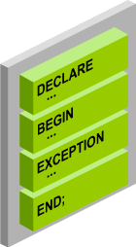
Pl/SQL Block Structure
DECLARE (optional)
Variables, cursors, user-defined exceptions
BEGIN (mandatory)
SQL statements
PL/SQL statements
EXCEPTION (optional)
Actions to perform when errors occur
END; (mandatory)
Notes:
PL/SQL Block Structure
The slide shows a basic PL/SQL block. A PL/SQL block consists of three sections:
Declarative (optional): The declarative section begins with the keyword DECLARE and ends when the executable section starts.
Executable (required): The executable section begins with the keyword BEGIN and ends with END. Observe that END is terminated with a semicolon. The executable section of a PL/SQL block can in turn include any number of PL/SQL blocks.
Exception handling (optional): The exception section is nested within the executable section. This section begins with the keyword EXCEPTION.
In a PL/SQL block, the keywords DECLARE, BEGIN, and EXCEPTION are not terminated by a semicolon. However, the keyword END, all SQL statements, and PL/SQL statements must be terminated with a semicolon.

Slide 7
Block Types
Block Types
Anonymous
Procedure
Function
[DECLARE]
BEGIN
--statements
[EXCEPTION]
END;
PROCEDURE name
IS
BEGIN
--statements
[EXCEPTION]
END;
FUNCTION name
RETURN datatype
IS
BEGIN
--statements
RETURN value;
[EXCEPTION]
END;
Notes:
Block Types
A PL/SQL program comprises one or more blocks. These blocks can be entirely separate or nested within another block. There are three types of blocks that make up a PL/SQL program. They are:
Anonymous blocks
Procedures
Functions
Anonymous blocks: Anonymous blocks are unnamed blocks. They are declared inline at the point in an application where they are to be executed and are compiled each time the application is executed. These blocks are not stored in the database. They are passed to the PL/SQL engine for execution at run time. Triggers in Oracle Developer components consist of such blocks. These anonymous blocks get executed at run time because they are inline. If you want to execute the same block again, you have to rewrite the block. You are unable to invoke or call the block that you wrote earlier because blocks are anonymous and do not exist after they are executed.

Slide 8





Identifiers
Identifiers are used for:
Naming a variable
Providing conventions for variable names
Must start with a letter
Can include letters or numbers
Can include special characters (such as dollar sign, underscore, and pound sign)
Must limit the length to 30 characters
Must not be reserved words

Slide 9
Declaring and Initializing PL/SQL Variables
DECLARE
emp_hiredate DATE;
emp_deptno NUMBER(2) NOT NULL := 10;
location VARCHAR2(13) := 'Atlanta';
c_comm CONSTANT NUMBER := 1400;

Slide 10
Declaring and Initializing PL/SQL Variables
SET SERVEROUTPUT ON
DECLARE
Myname VARCHAR2(20);
BEGIN DBMS_OUTPUT.PUT_LINE('My name is: '||Myname);
Myname := 'John';
DBMS_OUTPUT.PUT_LINE('My name is: '||Myname);
END;
/
SET SERVEROUTPUT ON
DECLARE
Myname VARCHAR2(20):= 'John';
BEGIN
Myname := 'Steven';
DBMS_OUTPUT.PUT_LINE('My name is: '||Myname);
END;
/

Slide 11
Types of Variables
PL/SQL variables:
Scalar
Composite
Reference
Large object (LOB)
Non-PL/SQL variables: Bind variables
Notes:
Types of Variables
All PL/SQL variables have a data type, which specifies a storage format, constraints, and a valid range of values. PL/SQL supports five data type categories—scalar, composite, reference, large object (LOB), and object—that you can use for declaring variables, constants, and pointers.
Scalar data types: Scalar data types hold a single value. The value depends on the data type of the variable. For example, the variable Myname in the example in slide 7 is of type VARCHAR2. Therefore, Myname can hold a string value. PL/SQL also supports Boolean variables.
Composite data types: Composite data types contain internal elements that are either scalar or composite. Record and table are examples of composite data types.
Reference data types: Reference data types hold values, called pointers, that point to a storage location.
LOB data types: LOB data types hold values, called locators, that specify the location of large objects (such as graphic images) that are stored out of line.
Non-PL/SQL variables include host language variables declared in precompiler programs, screen fields in Forms applications, and host variables. You learn about host variables later in this lesson.
For more information about LOBs, see the PL/SQL User’s Guide and Reference.

Slide 12
Base Scalar Data Types
CHAR [(maximum_length)]
VARCHAR2 (maximum_length)
LONG
LONG RAW
NUMBER [(precision, scale)]
BINARY_INTEGER
PLS_INTEGER
BOOLEAN
BINARY_FLOAT
BINARY_DOUBLE

Slide 13
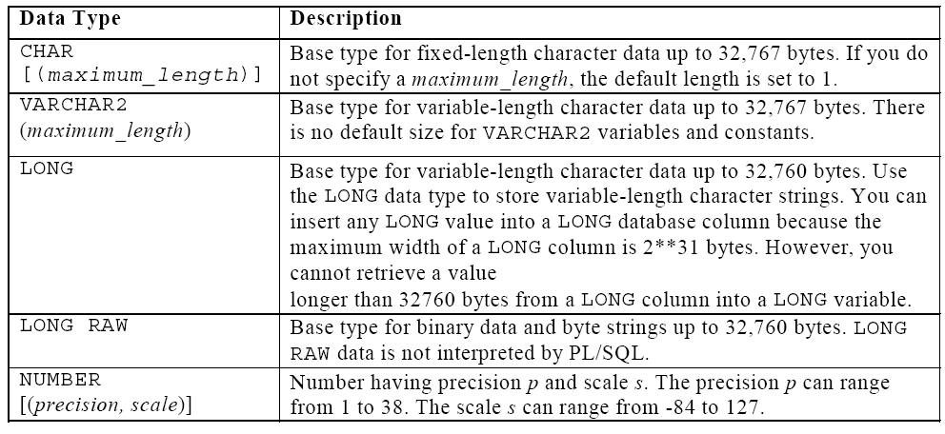
PL/SQL Data types Contd..

Slide 14
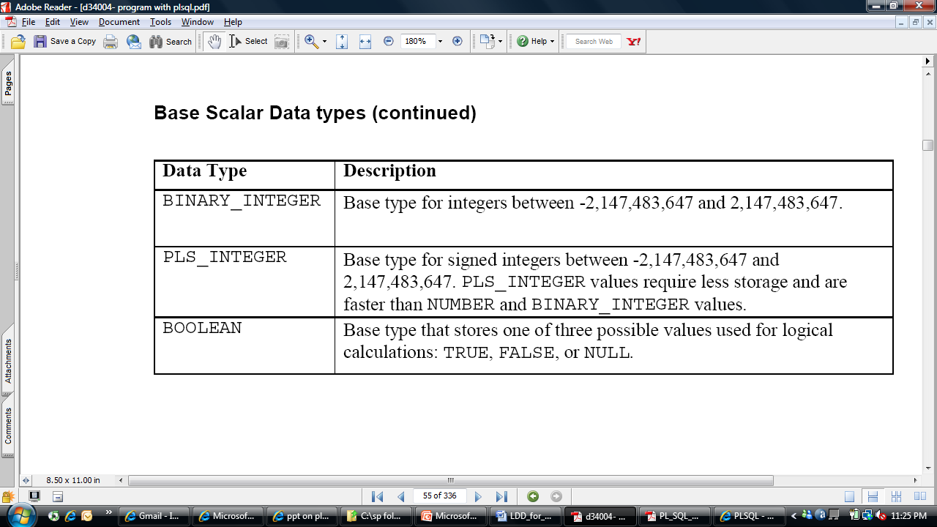
PL/SQL Data types Contd..

Slide 15
%TYPE Attribute
The %TYPE attribute
Is used to declare a variable according to:
A database column definition
Another declared variable
Is prefixed with:
The database table and column
The name of the declared variable
Notes:
%TYPE Attribute
PL/SQL variables are usually declared to hold and manipulate data stored in a database. When you declare PL/SQL variables to hold column values, you must ensure that the variable is of the correct data type and precision. If it is not, a PL/SQL error occurs during execution. If you have to design large subprograms, this can be time consuming and error prone.
Rather than hard-coding the data type and precision of a variable, you can use the %TYPE attribute to declare a variable according to another previously declared variable or database column. The %TYPE attribute is most often used when the value stored in the variable is derived from a table in the database. When you use the %TYPE attribute to declare a variable, you should prefix it with the database table and column name. If you refer to a previously declared variable, prefix the variable name to the attribute.

Slide 16
Bind Variables and Host Variables
Bind variables are:
Created in the environment
Also called host variables
Created with the VARIABLE keyword
Used in SQL statements and PL/SQL blocks
Accessed even after the PL/SQL block is executed
Referenced with a preceding colon
Notes:
Bind Variables
Bind variables are variables that you create in a host environment. For this reason, they are sometimes called host variables.
Uses of Bind Variables
Bind variables are created in the environment and not in the declarative section of a PL/SQL block. Variables declared in a PL/SQL block are available only when you execute the block. After the block is executed, the memory used by the variable is freed. However, bind variables are accessible even after the block is executed. When created, therefore, bind variables can be used and manipulated by multiple subprograms. They can be used in SQL statements and PL/SQL blocks just like any other variable. These variables can be passed as run-time values into or out of PL/SQL subprograms.
Creating Bind Variables
To create a bind variable in SQL Developer or in SQL*Plus, use the VARIABLE command. For example, you declare a variable of type NUMBER and VARCHAR2 as follows:
VARIABLE return_code NUMBER VARIABLE return_msg VARCHAR2(30)
Both SQL*Plus and SQL Developer can reference the bind variable, and SQL Developer can display its value through the SQL*Plus PRINT command.

Slide 17
Substitution Variables
Are used to get user input at run time
Are referenced within a PL/SQL block with a preceding ampersand
Are used to avoid hard-coding values that can be obtained at run time
VARIABLE emp_salary NUMBER SET AUTOPRINT ON DECLARE empno NUMBER(6):=&empno; BEGIN SELECT salary INTO :emp_salary FROM employees WHERE employee_id = empno; END; /
Notes:
Substitution Variables
Substitution variables can be used to pass run-time values into a PL/SQL block. You can reference substitution variables in SQL statements (and within a PL/SQL block) with a preceding ampersand. The text values are substituted into the PL/SQL block before the PL/SQL block is executed. Therefore, you cannot substitute different values for the substitution variables by using a loop. Even if you include the variable in a loop, you are prompted only once to enter the value. Only one value will replace the substitution variable.
When you execute the block in the slide, SQL Developer prompts you to enter a value for empno, which is the substitution variable.

Slide 18

Composite Data Types
TRUE 23-DEC-98 EMPLOYEE
PL/SQL table structure
1 SMITH 2 JONES 3 NANCY 4 TIM
1 5000 2 2345 3 12 4 3456
VARCHAR2
NUMBER
PLS_INTEGER
PLS_INTEGER
Notes:
Composite Data Types
A scalar type has no internal components. A composite type has internal components that can be manipulated individually. Composite data types (also known as collections) are of TABLE, RECORD, NESTED TABLE, and VARRAY types.
Use the TABLE data type to reference and manipulate collections of data as a whole object. Use the RECORD data type to treat related but dissimilar data as a logical unit. NESTED TABLE and VARRAY data types are covered in the Oracle Database 10g: Develop PL/SQL Program Units course.

Slide 19






LOB Data Type
Book
(CLOB)
Photo
(BLOB)
Movie
(BFILE)
NCLOB
Notes:
LOB Data Type Variables
Large objects (LOBs) are meant to store a large amount of data. A database column can be of the LOB category. With the LOB category of data types (BLOB, CLOB, and so on), you can store blocks of unstructured data (such as text, graphic images, video clips, and sound wave forms) up to 4 GB in size. LOB data types allow efficient, random, piecewise access to the data and can be attributes of an object type.
The character large object (CLOB) data type is used to store large blocks of character data in the database.
The binary large object (BLOB) data type is used to store large unstructured or structured binary objects in the database. When you insert or retrieve such data to and from the database, the database does not interpret the data. External applications that use this data must interpret the data.
The binary file (BFILE) data type is used to store large binary files. Unlike other LOBS, BFILES are not stored in the database. BFILEs are stored outside the database. They could be operating system files. Only a pointer to the BFILE is stored in the database.
The national language character large object (NCLOB) data type is used to store large blocks of single-byte or fixed-width multibyte NCHAR unicode data in the database.

Slide 20
Composite Data Types
Can hold multiple values (unlike scalar types)
Are of two types:
PL/SQL records
PL/SQL collections
INDEX BY tables or associative arrays
Nested table
VARRAY

Slide 21
PL/SQL Records
Must contain one or more components (called fields) of any scalar, RECORD, or INDEX BY table data type
Are similar to structures in most 3GL languages (including C and C++)
Are user defined and can be a subset of a row in a table
Treat a collection of fields as a logical unit
Are convenient for fetching a row of data from a table for processing
Notes:
PL/SQL Records
A record is a group of related data items stored in fields, each with its own name and data type.
Each record defined can have as many fields as necessary.
Records can be assigned initial values and can be defined as NOT NULL.
Fields without initial values are initialized to NULL.
The DEFAULT keyword can also be used when defining fields.
You can define RECORD types and declare user-defined records in the declarative part of any block, subprogram, or package.
You can declare and reference nested records. One record can be the component of another record.

Slide 22
Creating a PL/SQL Record
DECLARE
TYPE emp_record_type IS RECORD(employee_id NUMBER(6) NOT NULL:= 100,
last_name employees.last_name%TYPE,job_id employees.job_id%TYPE); emp_record emp_record_type;
Notes:
Creating a PL/SQL Record
PL/SQL records are user-defined composite types. To use them:
1. Define the record in the declarative section of a PL/SQL block. The syntax for defining the record is shown in the slide.
2. Declare (and optionally initialize) the internal components of this record type.
In the syntax:
type_name Is the name of the RECORD type (This identifier is used to declare records.)
field_name Is the name of a field within the record
field_type Is the data type of the field (It represents any PL/SQL data type except REF CURSOR. You can use the %TYPE and %ROWTYPE attributes.)
expr Is the field_type or an initial value
The NOT NULL constraint prevents assigning nulls to those fields. Be sure to initialize the NOT NULL fields. REF CURSOR is covered in Appendix C “REF Cursors.”
Field declarations used in defining a record are like variable declarations. Each field has a unique name and a specific data type. There are no predefined data types for PL/SQL records, as there are for scalar variables. Therefore, you must create the record type first and then declare an identifier using that type.
In the example in the slide, a record type (emp_record_type) is defined to hold the values for last_name, job_id, and salary. In the next step, a record (emp_record) of the type emp_record_type is declared.

Slide 23
PL/SQL Record Structure
Field1 (data type)
Field2 (data type)
Field3 (data type)
employee_id number(6)
last_name varchar2(25)
job_id varchar2(10)
100 King Manager

Slide 24
%ROWTYPE Attribute
Declare a variable according to a collection of columns in a database table or view.
Prefix %ROWTYPE with the database table or view.
Fields in the record take their names and data types from the columns of the table or view.
Notes:
%ROWTYPE Attribute
You have learned that %TYPE is used to declare a variable of a column type. The variable has the same data type and size as the table column. The benefit of %TYPE is that you do not have to change the variable if the column is altered. Also, if the variable is used in any calculations, you need not worry about its precision.
The %ROWTYPE attribute is used to declare a record that can hold an entire row of a table or view. The fields in the record take their names and data types from the columns of the table or view. The record can also store an entire row of data fetched from a cursor or cursor variable.
The slide shows the syntax for declaring a record. In the syntax:
identifier Is the name chosen for the record as a whole
reference Is the name of the table, view, cursor, or cursor variable on which the record is to be based (The table or view must exist for this reference to be valid.)
In the following example, a record is declared using %ROWTYPE as a data type specifier:
DECLARE emp_record employees%ROWTYPE;
Advantages of Using %ROWTYPE
The advantages of using the %ROWTYPE attribute are listed in the slide. Use the %ROWTYPE attribute when you are not sure about the structure of the underlying database table.
The main advantage of using %ROWTYPE is that it simplifies maintenance. Using %ROWTYPE ensures that the data types of the variables declared with this attribute change dynamically when the underlying table is altered. If a DDL statement changes the columns in a table, then the PL/SQL program unit is invalidated. When the program is recompiled, it will automatically reflect the new table format.
The %ROWTYPE attribute is particularly useful when you want to retrieve an entire row from a table. In the absence of this attribute, you would be forced to declare a variable for each of the columns retrieved by the select statement.

Slide 25

Cursors
Every SQL statement executed by the Oracle server has an associated individual cursor:
Implicit cursors: Declared and managed by PL/SQL for all DML and PL/SQL SELECT statements
Explicit cursors: Declared and managed by the programmer
Notes:
Cursors
The Oracle server uses work areas (called private SQL areas) to execute SQL statements and to store processing information. You can use explicit cursors to name a private SQL area and to access its stored information.
The Oracle server implicitly opens a cursor to process each SQL statement that is not associated with an explicitly declared cursor. Using PL/SQL, you can refer to the most recent implicit cursor as the SQL cursor.

Slide 26
Controlling Explicit Cursors
No
DECLARE
OPEN
FETCH
CLOSE
Yes
EMPTY?
Create a named SQL area.
Identify the active set.
Load the current row into variables.
Test for existing rows.
Release the active set.
Return to FETCH if rows are found.
Notes:
Controlling Explicit Cursors
Now that you have a conceptual understanding of cursors, review the steps to use them.
1. In the declarative section of a PL/SQL block, declare the cursor by naming it and defining the structure of the query to be associated with it.
2. Open the cursor. The OPEN statement executes the query and binds any variables that are referenced. Rows identified by the query are called the active set and are now available for fetching.
3. Fetch data from the cursor. In the flow diagram shown in the slide, after each fetch you test the cursor for any existing row. If there are no more rows to process, you must close the cursor.
4. Close the cursor. The CLOSE statement releases the active set of rows. It is now possible to reopen the cursor to establish a fresh active set.

Slide 28






Controlling Flow of Execution
for
loop
while

Slide 29
Iterative Control: LOOP Statements
Loops repeat a statement or sequence of statements multiple times.
There are three loop types:
Basic loop
FOR loop
WHILE loop

Slide 30
DECLARE
myage number:=31;
BEGIN
IF myage < 11
THEN
DBMS_OUTPUT.PUT_LINE(' I am a child ');
ELSE
DBMS_OUTPUT.PUT_LINE(' I am not a child ');
END IF;
END;
/
DECLARE
grade CHAR(1) := UPPER('&grade');
appraisal VARCHAR2(20);
BEGIN
appraisal :=
CASE grade
WHEN 'A' THEN 'Excellent'
WHEN 'B' THEN 'Very Good'
WHEN 'C' THEN 'Good'
ELSE 'No such grade'
END;
DBMS_OUTPUT.PUT_LINE ('Grade: '|| grade || ' Appraisal ' || appraisal);
END;
/
declare
n_num number := 1;
begin
loop
dbms_output.put(n_num||', ');
n_num := n_num + 1;
exit when n_num > 5;
end loop;
dbms_output.put_line('Final: '||n_num);
end;
/
DECLARE
salary number;
BEGIN
dbms_output.put_line('Enter the emp no');
SELECT sal into salary from emp where empno=&empno ;
WHILE salary<= 4000
LOOP
salary := salary * 31;
dbms_output.put_line(salary);
END LOOP;
end;
/

Slide 31
DECLARE
step PLS_INTEGER := 2;
BEGIN
FOR i IN 1..3 LOOP
DBMS_OUTPUT.PUT_LINE (i*step);
END LOOP;
END;
/

